Slide 1
U.S. Census Insight:
Predicting Adult Income
February 19, 2021

Slide 2
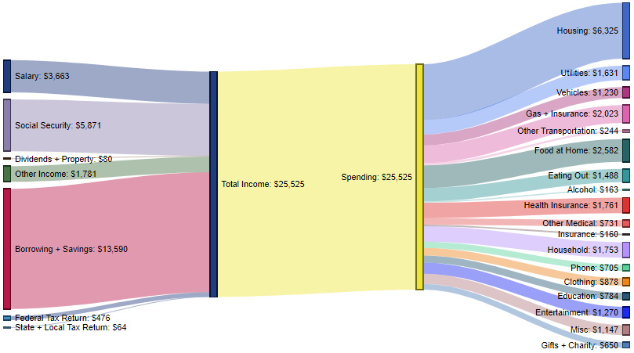
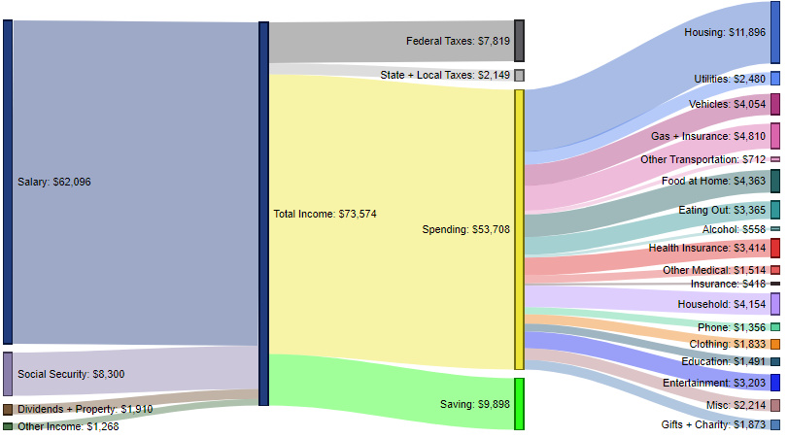
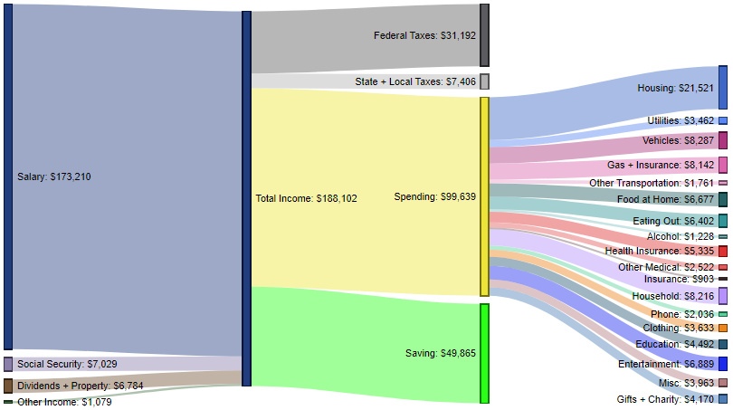
Proposal
Americans income-to-expense ratio varies by income level.
What factors will allow us to accurately predict the annual income of adults in the US?
If we can predict income, we can predict expenditure.
*Desjardins, https://www.visualcapitalist.com/how-americans-make-spend-money/

Slide 3
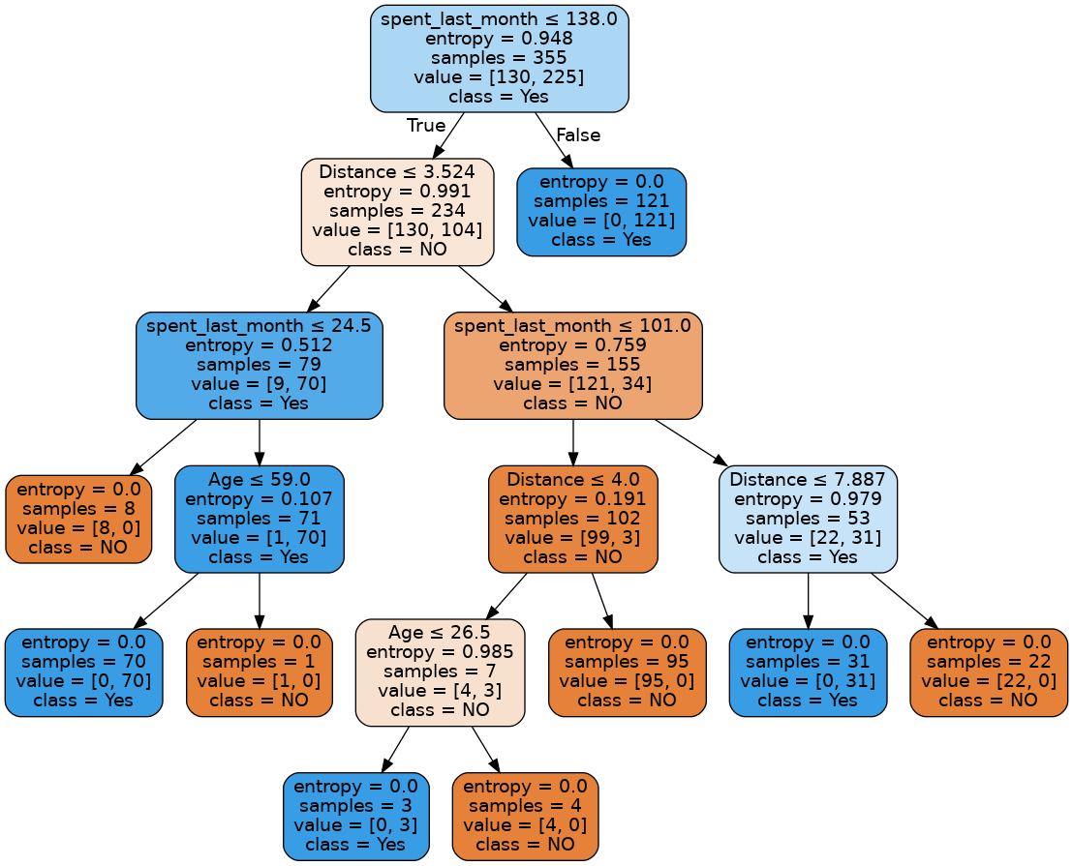
The Methodology
Clean the data to be categorical in nature.
Create a categorical model with a RandomForest algorithm.
Train a model to correctly categorize the income level of adults.

Slide 4
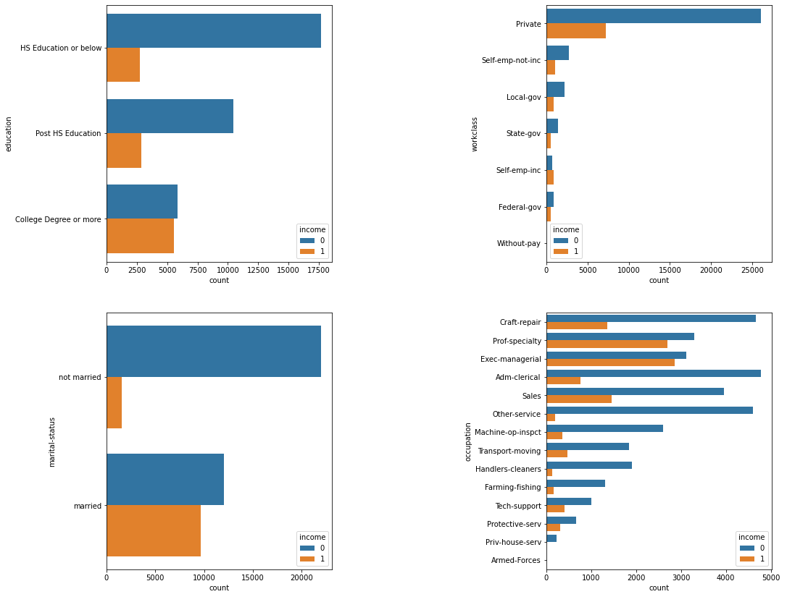
Cleaning
Binary Income:
0 assigned <= $50k/year, 1 assigned >$50k/year
Education cleaned into 3 categories
Little difference and representation in lower/higher education extremes
Marital status simplified to binary
Little variation in income via technical status (ex: “widowed” vs. “never married” have similar income ratios)

Slide 5
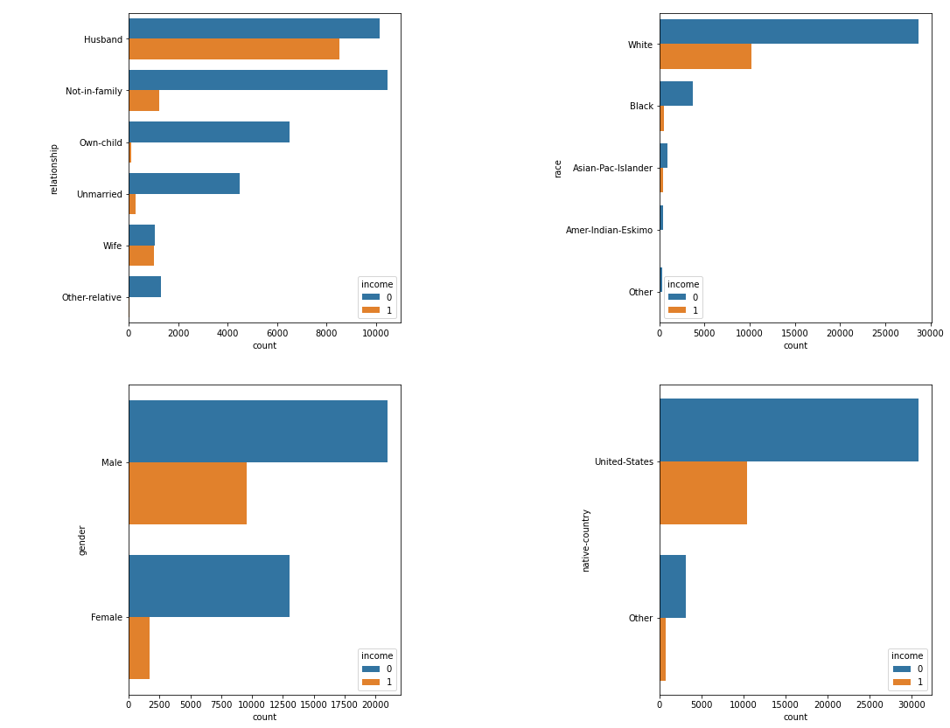
Cleaning (cont.)
Race & native country - Not enough data representation to be reliable in categorical model.
Gender and relationship show strong trends in relation to income.
Relationship is in regards to others in the home.

Slide 6
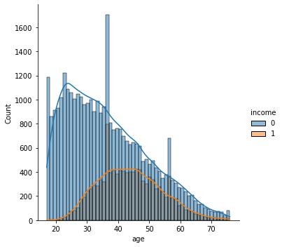
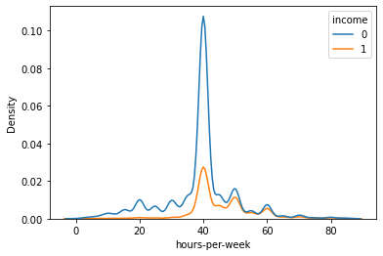
Cleaning (cont.)
Age shows strong correlation to income values; with a tail to the outlier ages of 70+.
Removed the 1% outliers
Hours-per-week is focused in on an average of 40; as expected.
< 40 hours/week not conducive with making >$50k?

Slide 7
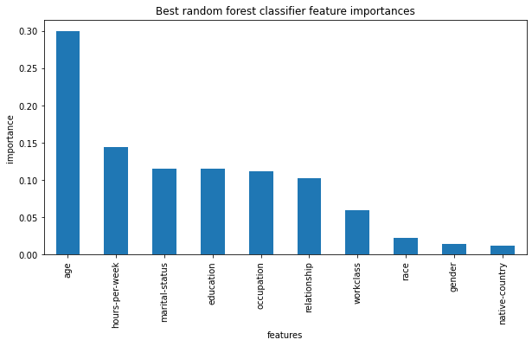
Feature Identification
No feature has a higher score than 30% correlation to income.
As predicted, race had little value in predicting income from this dataset.
Top 5 features:
Age ~ 30%
Hours-per-week ~ 15%
Marital Status ~12%
Education ~ 12%
Occupation ~12%

Slide 8
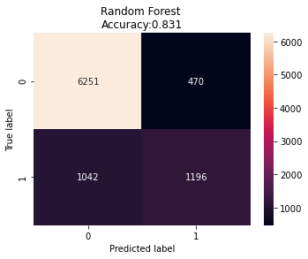
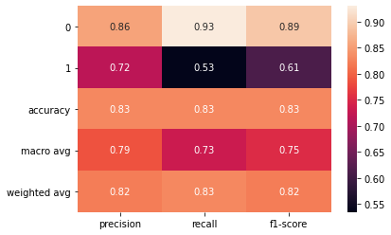
Results of Random Forest Model
Trained on 80% of data, tested on 20%.
Training accuracy: 85%
Testing Accuracy: 83.1%
Recall or True Positive Rate
(TP/(TP+FN): 83%, better w/ <= $50k data
Precision
(TP/(FP+TN): 82%, better w/ <= $50k data
F1-score
(2*P*R/(P+R): 82%
It is a harmonic mean of precision and recall
Accuracy
((TP+TN)/(N+P)): Overall ~83%
Percentage of total items classified correctly

Slide 9
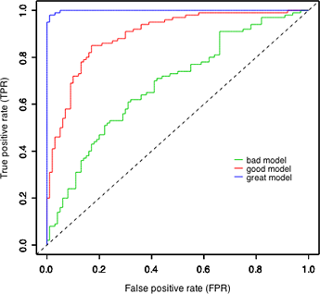
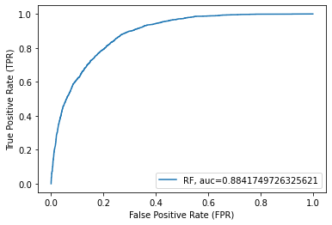
Results of Random Forest Model
Great? Good? Bad?!
ROC-AUC Score:
Likelihood of randomly choosing a positive case & negative case where the positive case outranks the negative case according to the classifier.
Our model’s score: 88.4%; pretty good.

Slide 10
Conclusions
We can accurately predict the income level of an adult in the US with an error of < 12%.
Allows us to predict expenses, savings, and taxes.
Enables tailored marketing to demographics according to expenses.
For the future:
Need more representative data of minorities & immigrants
Consider adding more income tiers, changing from binary classification to a new model.

